Slide 1
Automated Data Mapping POC Solution Approach Note
For Ulysses Systems
Version 1.0 04Nov2025

Slide 2
Introduction
Client Background
Ulysses Systems is a maritime software provider specialising in vessel management and maintenance systems. Their platform integrates structured data for vessel components, spares, and maintenance activities from OEM manuals.
Challenges
Manual and inconsistent data extraction from OEM manuals and activity sheets.
Varying document structures across equipment types.– Duplicate records requiring manual verification.
Limited traceability and high SME dependency.
Ulysses Systems has engaged Merit to design and implement an automated data mapping solution to address the above challenges.
Engagement Objective
Merit has been engaged to design and implement an automated data-mapping solution addressing these challenges and accelerating vessel onboarding.

Slide 3





Ulysses Systems Automation Objectives
Automate and streamline data extraction and mapping from vessel manuals for faster, more accurate onboarding with minimal manual effort.
Data Extraction Automation
Automate the extraction, parsing, and structuring of data from OEM manuals to align with Ulysses’ target schema.
Accelerated Data Delivery
Enable quicker turnaround of structured outputs for import into the Ulysses application, ensuring timely system updates.
Improved Data Accuracy and Consistency
Enhance data reliability and reduce human errors through semi automated validation and standardisation steps.
01
05
02
04
03
Maximise Efficiencies
Achieve greater operational efficiency through automated workflows and reduced dependency on subject-matter experts.
Reduce Manual Effort
Minimise or eliminate manual data entry and mapping wherever possible, improving overall turnaround time.
3

Slide 4

Solution Design and Implementation Approach
Table Detection and Extraction : Detect tables in complex PDF layouts using open-source tools and perform OCR using LLM-enhanced models.
Content Extraction : Extract text and tabular data, including spare parts images, and store them in designated folders.
Validation and Transformation: Use LLMs to restructure extracted tables and perform rule-based transformations as per client mapping standards.
Analysis & Planning
Activity Mapping (Hard Complexity)
1
Analyse sample PDFs and classify them into Easy, Medium, and Hard categories.
Evaluate suitable OCR models and apply image enhancement to improve accuracy.
Use LLMs and rules for post-processing and duplicate detection to ensure high-quality, non-redundant data.
4
Development
2
Deduplication Module: Develop a Python module using hash functions and key identifiers (e.g., Make, Model No.) to identify duplicate or similar manufacturer data in the master database.
Develop a Python-based Human-in-the-Loop module for post–table extraction validation, enabling human reviewers to verify data accuracy directly from Excel outputs without a UI during the PoC.
5
Integration & Publishing
5
Integrate all developed modules into a unified, end-to-end workflow covering OCR, transformation, and mapping.
Implement Human-in-the-Loop quality checks post-integration to validate and ensure data accuracy, completeness, and consistency.
Deliver final validated outputs in structured Excel format and publish to the designated SFTP location.
Spare Parts Mission
Easy Complexity: Perform OCR using open-source libraries, validate and restructure extracted tables with LLMs, and apply rule-based and LLM-driven transformations as per client-defined mapping instructions.
Medium Complexity: Detect and extract tables using LLM-based models, validate and refine their structure for accuracy, and apply rule-based and LLM transformations to match client-specified data formats.
3

Slide 5
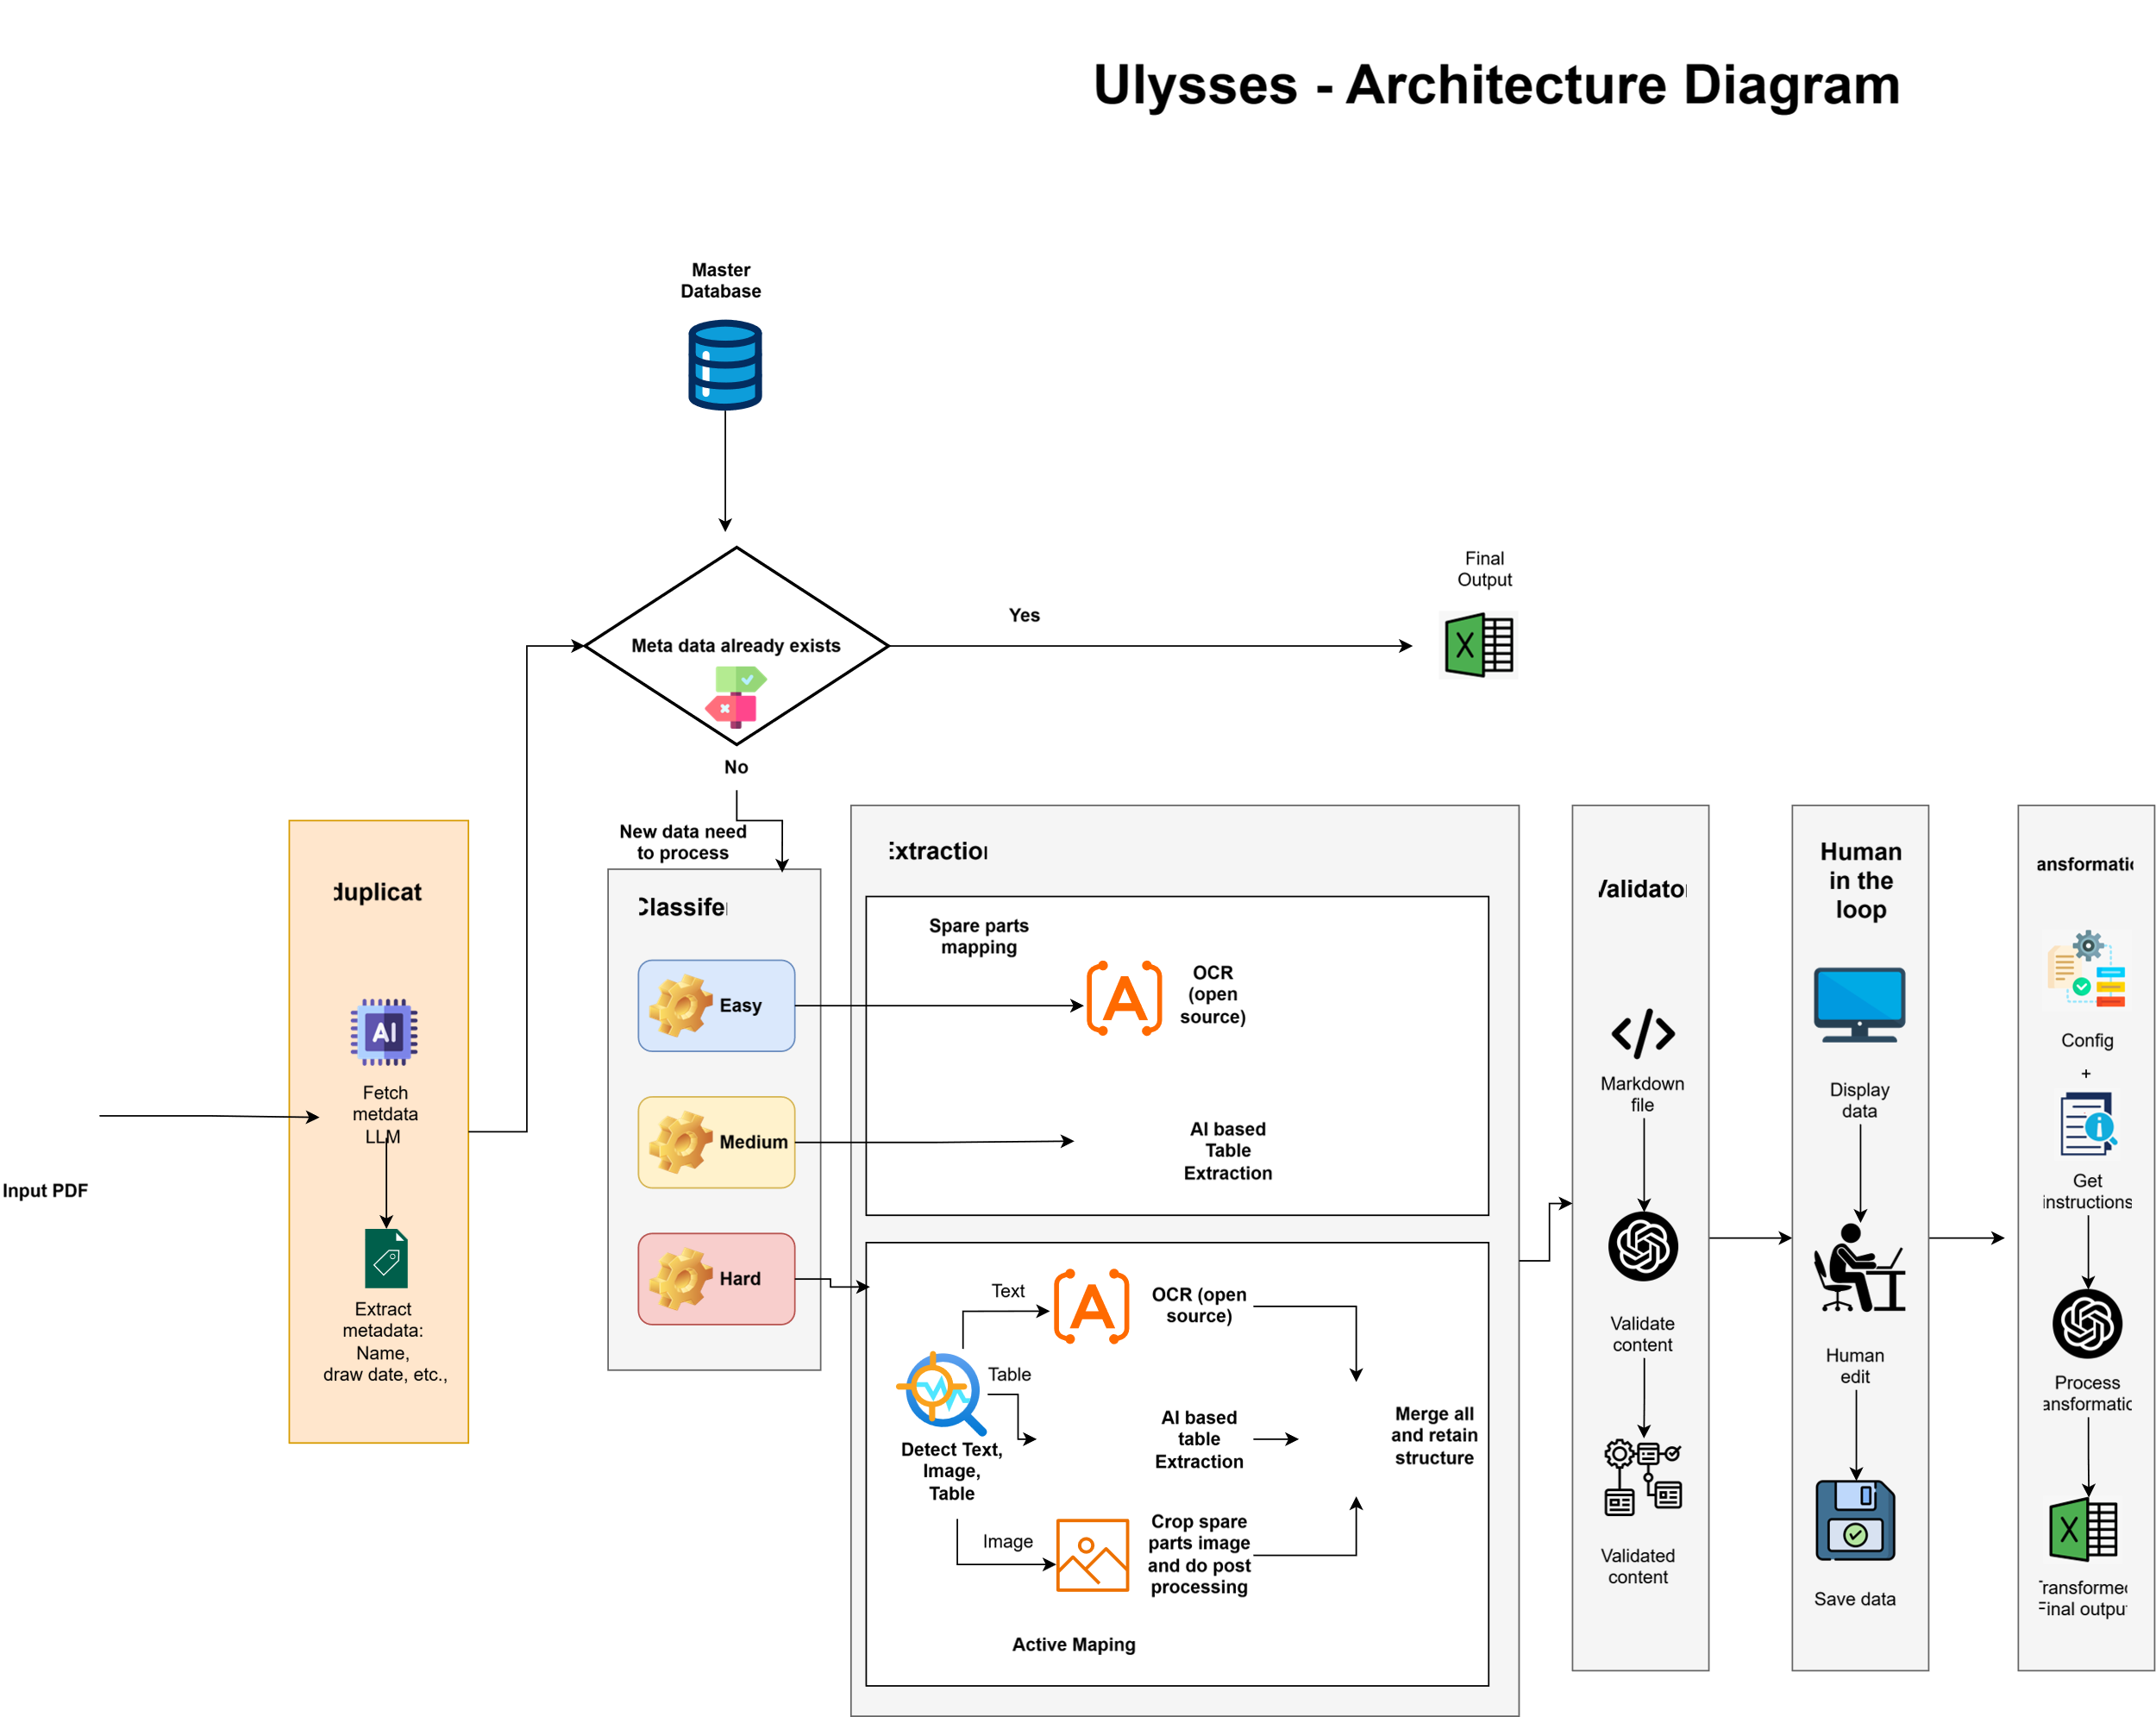
Technical Architecture Diagram (requested for a clearer diagram)

Slide 6
POC Objectives
The primary objective of the POC is to demonstrate Merit’s capabilities deduplication of existing documents and automating data extraction from PDFs, mapping, and deduplication from vessel manuals. The solution’s capability to:
Perform Deduplication using hash-based and Make/Model logic.
Automate extraction of key data fields from table
Map extracted data from tables in PDFs to Ulysses’ schema.
Reduce manual effort by leveraging AI-driven parsing and enrichment with human-in-the-loop verification to ensure high quality
Deliver faster turnaround for documents to Ulysses System
Demonstrates scalability of the solution across multiple regions, sectors, and deal types

Slide 7
Proposed POC – What’s In Scope and Out of Scope
Scope
Process a representative sample of manuals and activity sheets covering three levels of document complexity, drawn from different vessel types, and automatically extract and map key data fields to Ulysses’ defined schema, supported by validation logic and human-in-the-loop review to ensure accuracy, consistency, and completeness of the mapped data.
POC Input
Spare Part Manual : 90 Sources
Activity Sheet : 10 Sources
To be supplied by the customer
POC Output
Spare Part Manual : Mapped Output Data
Activity Sheets : Mapped Output data
List of data points provided in Appendix I
Out of Scope
Non-English manuals.
Integration with production systems.
POC Output Data Delivery
Delivered as a .xlsx file (using approved data delivery template for both Spare Part Manual and Activity Sheet) into a secure SFTP location

Slide 8
POC Effort and Cost Estimates
Description | Estimated Cost
Discovery, Analysis and Planning | £2,800.00
De-duplication | £1,200.00
Human-in-the-loop | £1,200.00
Easy & Medium Complexity - Spare Parts Mapping Development | £3,720.00
Hard Complexity - Activity Mapping | £5,810.00
Integration and QA | £1,920.00
Testing - Pipeline | £400.00
Documentation | FOC
Project Management | FOC
Infrastructure Cost | £1,400.00
Total Solution Set Up / Configuration Costs For POC | £18,450.00
S.No | Estimated Infrastructure | Estimated Cost
1 | Virtual Machines(Ubuntu) | £1,000
2 | Open AI Cost | £400
Total |  | £1,400
Note:
The costs are only indicative and based on analysis and better understanding the estimates might vary​
Any alteration or expansion of the project's scope will also have an effect on the estimates provided above​
Infrastructure costs are estimates and will be billed on actuals​
The pricing mentioned above shall expire 30 business days following the date of this proposal unless accepted in its entirety prior to the expiration date.​

Slide 9
POC Key Milestones and Projected Timelines
Milestones | Estimated Duration | Planned Start Date | Planned End Date
POC Milestones and Timelines
POC Solution Configuration | 8 Weeks | 17-Nov-25 | 16-Jan-26*
POC UAT (output checks by Ulysses System) | 2 Weeks | 19-Jan-26 | 30-Jan-26
POC UAT Issue Fixes | 1 Week | 02-Feb-26 | 09-Feb-26
*Excluding Christmas holidays – 1 week

Slide 10
Queries
Overall Volume of Vessels: Please confirm the overall count of the vessels for which the manuals will be covered under the full activity.
Split of Volume: Kindly provide the approximate distribution between Spare Parts manuals and Activity Sheets in overall volume.
Average Document Size: What is the average number of pages per document for both Spare Parts manuals and Activity Sheets?
Frequency of Activity: Is this intended to be a one-time activity, or will data extraction need to be refreshed on a monthly basis?
Consistency of Format: Based on your experience over the past six months, will the PDF format remain consistent across the manuals provided by the companies?
Instruction Variability in Activity Sheets: Will the maintenance instructions in the Activity Sheets follow a generic pattern, or will they vary depending on the company or equipment type?

Slide 11
Our Assumptions
Access will be provided to Ulysses database for deduplication.
PDF templates will be consistent across the company for future releases also.
English-only manuals for the POC.
SMEs available for timely feedback and validation.

Slide 12
Key Value Adds
A truly end-to-end easily scalable semi automated solution that will help reduce the manual efforts by 50-60%
The proposed solution guarantees significant increase in output volume, enhanced coverage, completeness and accuracy
A dedicated Project Manager and Business Analyst will be assigned to oversee the engagement at no additional cost, ensuring smooth delivery and stakeholder alignment throughout the project duration.
Documentation is FoC (Free of Charge), that will de-risks any knowledge transfer gaps due to change in personnel
Our accelerator platforms components have also helped in and estimated timeline reduction from 2.5 months to 2 months, as a result of in-built modules, automation utilities, and optimised data processing workflows in these platforms
Note: Infrastructure costs indicated are provisional estimates and will be billed based on actual usage during implementation.

Slide 13
Appendix I – Data Points
Spare Part Manual
Activity Sheets
ID
Description
PartNo
AltDesc
AltPartNo
ModelNo
OfficeNo
LeadTime
Weight
MSL
DrawingNumber
PositionNumber
Critical
LastPrice
Quantity
AccountCodeID
ManufacturerID
ID
ActivityTypeID
Name
Description
Interval
IntervalType
PercentTrigger
DryDock
FullReport
LetSlip
LetSlip2
MakerInterval
Critical
SurveyJob
Surveyable

